Slide 1
EEE 342/ETE418
Control Engineering
Fall 2019
Lecture # 01
25 September 2019

Slide 2
Outline
Instructor: Dr. Touhidur Rahman (ToR)
Schedule:
EEE342.1/ETE418.1 – MW – 9.40AM – 11.10AM
EEE342.2/ETE418.2 – MW – 1.00PM – 2.30PM
Location:
EEE342.1/ETE418.1 – SAC 205
EEE342.2/ETE418.2 – SAC 513
Office hours: Sunday – Wednesday 8.30AM – 9.30AM, Thursday 8.30AM – 11.00AM
Office: SAC 921
Email: touhidur.rahman01@northsouth.edu
Google classroom: EEE342ETE418FALL2019
Code: l1fl7gl

Slide 3
Grading Policy
Distribution of numerical scores
Item | %
Class Attendance | 5 | Attendance of 80% and above of all classes equals to 5% of grade points; Attendance of 40% and under of all classes equals to 0% of grade points; 40% - 80% of attendance of all classes will be scaled appropriately towards grade points.
Quiz | 25 | Total of 7 quizzes, best 2 out of quiz # 01-04 and best 2 out of quiz # 05 – 07 will be counted toward grade points.
Assignment | 25 | Total of 7 assignments, best 2 out of assignment # 01-04 and best 2 out of assignment # 05 – 07 will be counted toward grade points.
Midterm | 20 | One and half hour
Final | 25 | One and half hour

Slide 4
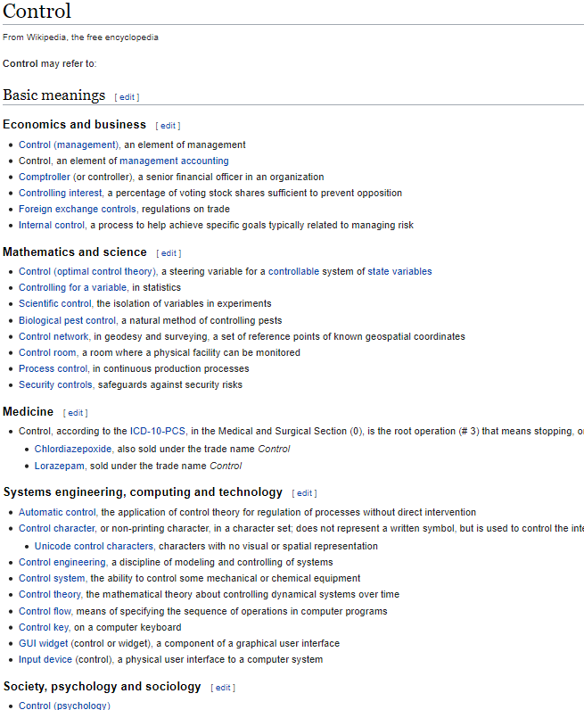



Control
Google:
Wikipedia: en.wikipedia.org/wiki/Control
Applied to many different areas in life
Science and engineering
Experiments
Business - spending
Social - respect
Personal – maintaining a daily routine
Images are from google search.

Slide 5
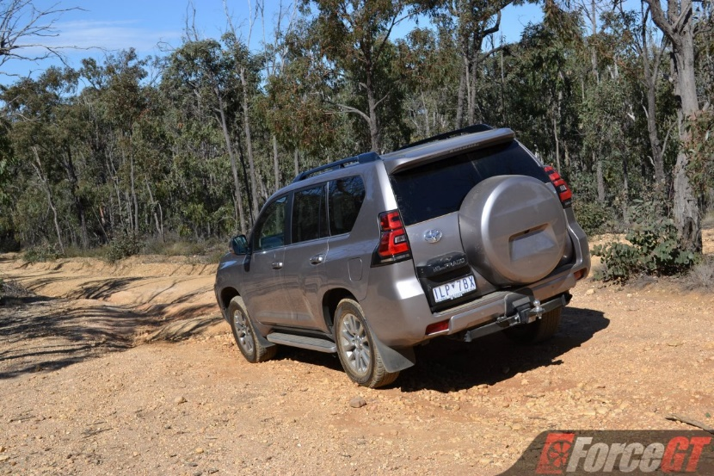
Engineering Control
Engineering: Engineering is the use of scientific principles to design and build machines, structures, and other items, including bridges, roads, vehicles, and buildings. The discipline of engineering encompasses a broad range of more specialized fields of engineering, each with a more specific emphasis on areas of applied mathematics, applied science, and types of application.
Control: in general
Determine the current state – sampling
Determine what to do and what no to do – decision based on scientific principles (Engineering)
Implement accordingly – action by actuator
Apply Accelerator/Brake
petrol
Speed
Input
Output
actuator
Decision
Apply brake?
How hard?
Check Speed
Sample
Engineering
Based on the knowledge of speed, terrain and the property of the vehicle

Slide 6
Class exercise
Class exercise:
Total 5 groups
One of group member will present on the board
Write down some examples of engineering control
Identify each component in your example
Determine the current state – sampling
Determine what to do and what no to do – decision based on scientific principles (Engineering)
Implement accordingly – action by actuator

Slide 7
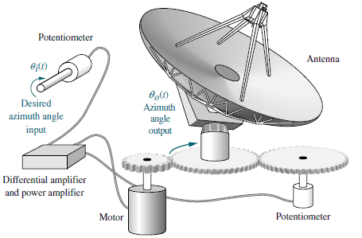
Few more examples of engineering control
Control System Engineering, 6th Edition
Norman S. Nise
Apply Accelerator/Brake
angle
TV Picture
Input
Output
actuator
Decision
Change of angle. How much?
Picture quality
Sample
Engineering
Knowledge of location of source of signal

Slide 8
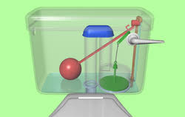
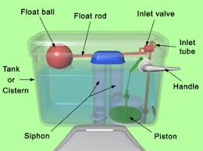
Example # 02
Input
Output
actuator
Decision
Sample
Engineering

Slide 9
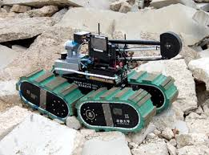
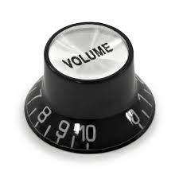
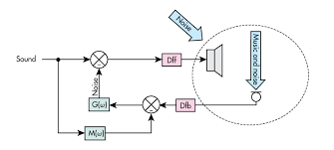
Advantages of Control Systems
1. Power amplification – steering wheel
2. Remote control – rescue robot
3. Convenience of input form – volume control
4. Compensation for disturbances – speaker – mic system

Slide 10
Focus of this course
Not the scientific principles – however, may need go through for basic understanding – case by case
Primary focus to learn mathematical tools

Slide 11
Prerequisite
EEE 221 Signals and Systems
Types of signal
Laplace transform
Fourier transform
Properties for system
Impulse response
Use of Laplace and Fourier transform for system analysis
MATLAB

Slide 12
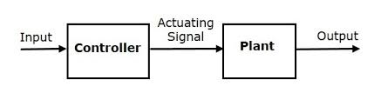
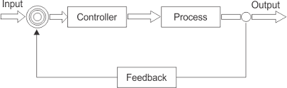
Types of control systems
Open loop system
Closed loop system
Computer controlled system

Slide 13
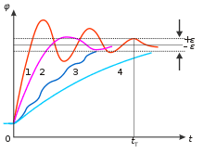
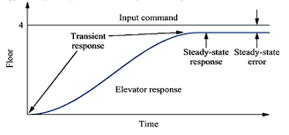
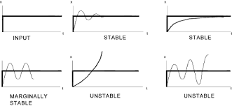
Analysis and Design Objectives
Primary
Transient Response
Steady-State Response
Stability
Secondary
Appropriate component
Cost
Robust

